Slide 1
Simulation and Modeling
Lecture 13
Generating Random Variates
Muhammad Mahbub Alam
Professor
CSE Department, IUT

Slide 3
Introduction
Generating Random Numbers
Obtaining sample values of a random variable having uniform continuous distribution in [0, 1]
Generating Random variates
Obtaining sample values of a random variable having the desired distribution

Slide 4
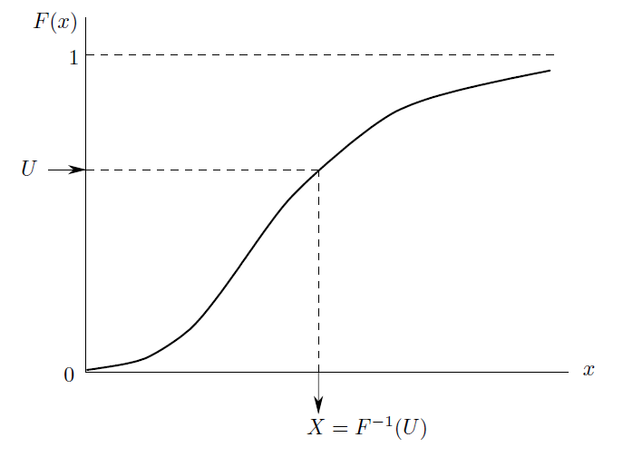
Inverse Transform Method

Slide 5
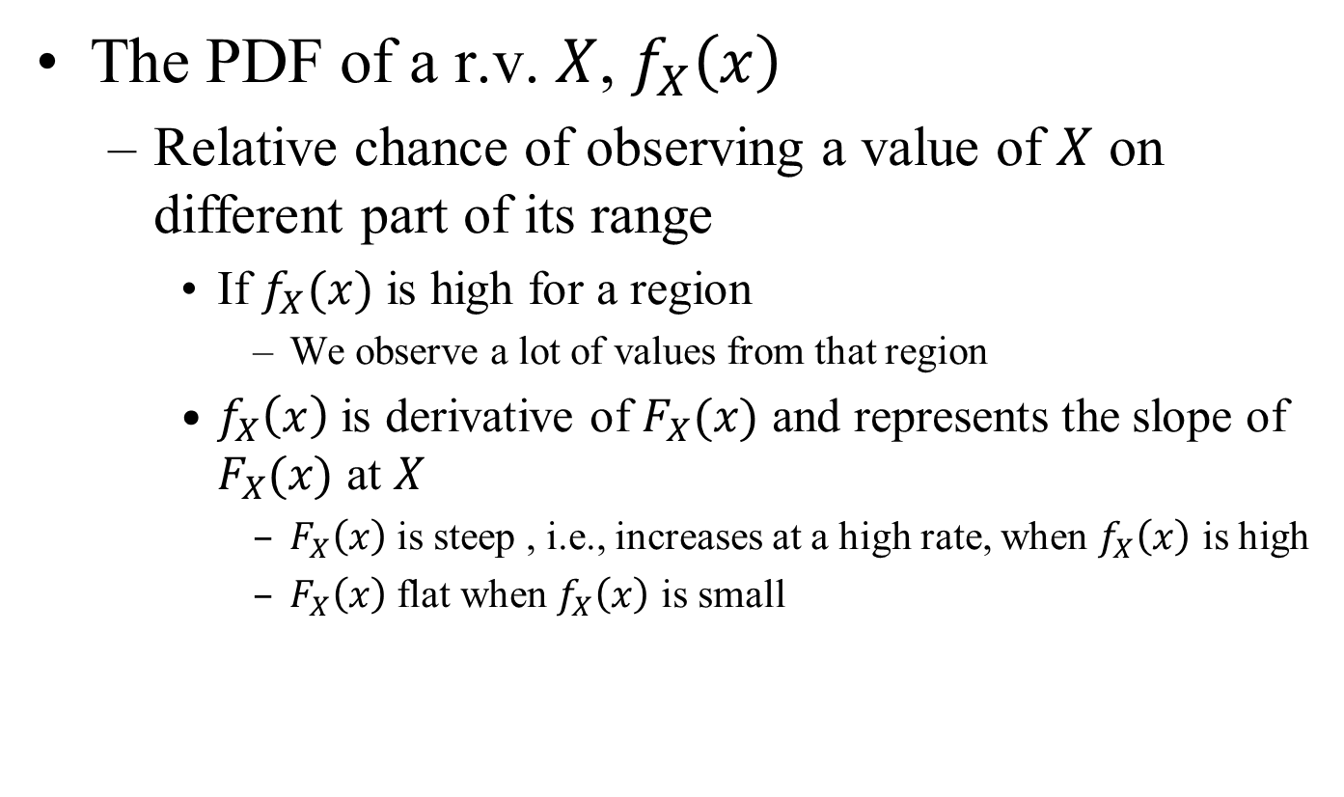
Inverse Transform Method
The PDF of a r.v. $X$, $f_{X}\left(x\right)$
Relative chance of observing a value of $X$ on different part of its range
If $f_{X}(x)$ is high for a region
We observe a lot of values from that region
$f_{X}\left(x\right)$ is derivative of $F_{X}(x)$ and represents the slope of $F_{X}(x)$ at $X$
$F_{X}\left(x\right)$is steep , i.e., increases at a high rate, when $f_{X}\left(x\right)$ is high
$F_{X}\left(x\right)$flat when $f_{X}\left(x\right)$ is small

Slide 6
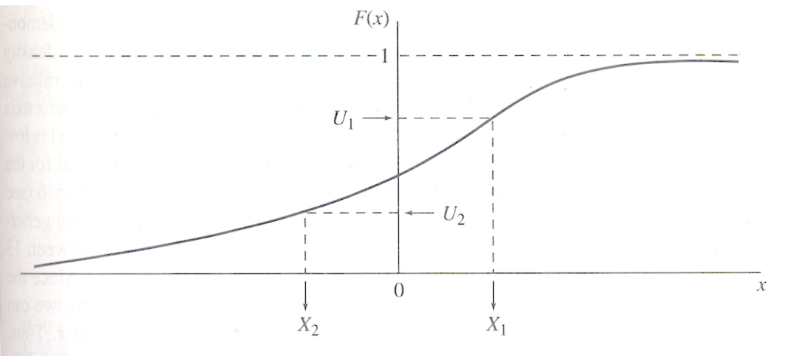
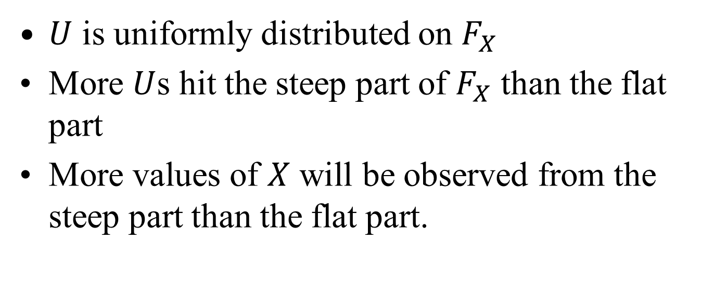
Inverse Transform Method
$U$ is uniformly distributed on $F_{X}$
More $U$s hit the steep part of $F_{X}$ than the flat part
More values of $X$ will be observed from the steep part than the flat part.

Slide 7
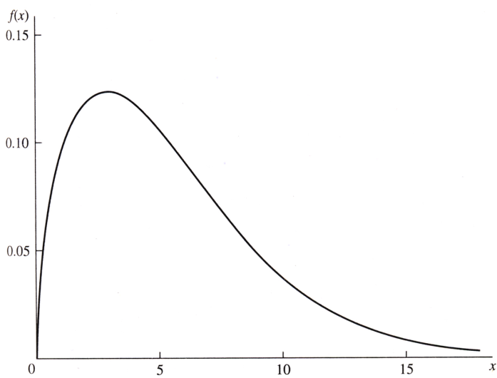
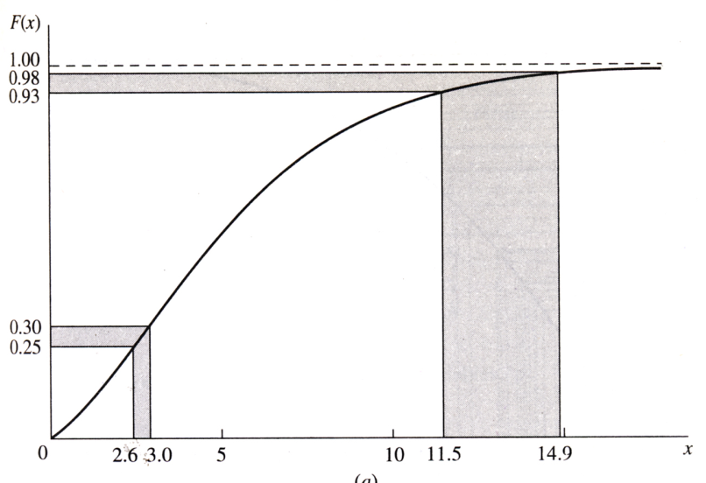
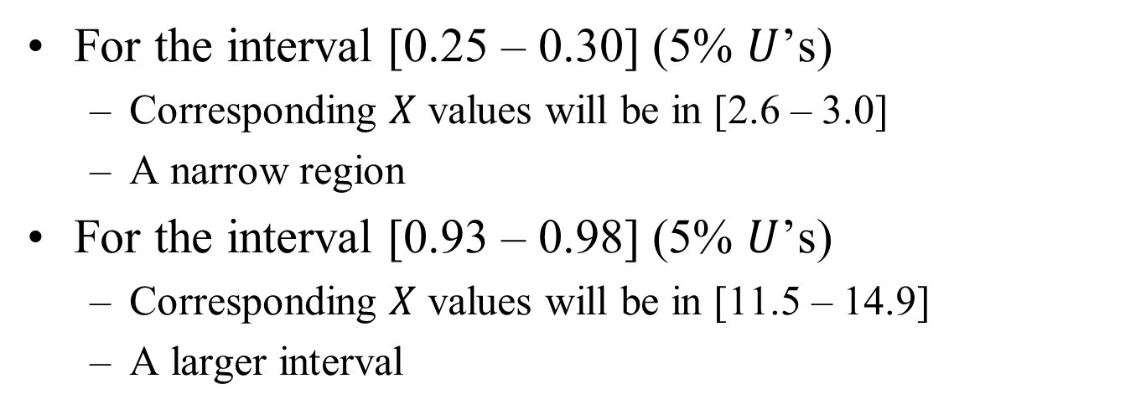
For the interval [0.25 – 0.30] (5% $U$’s)
Corresponding $X$ values will be in [2.6 – 3.0]
A narrow region
For the interval [0.93 – 0.98] (5% $U$’s)
Corresponding $X$ values will be in [11.5 – 14.9]
A larger interval

Slide 8
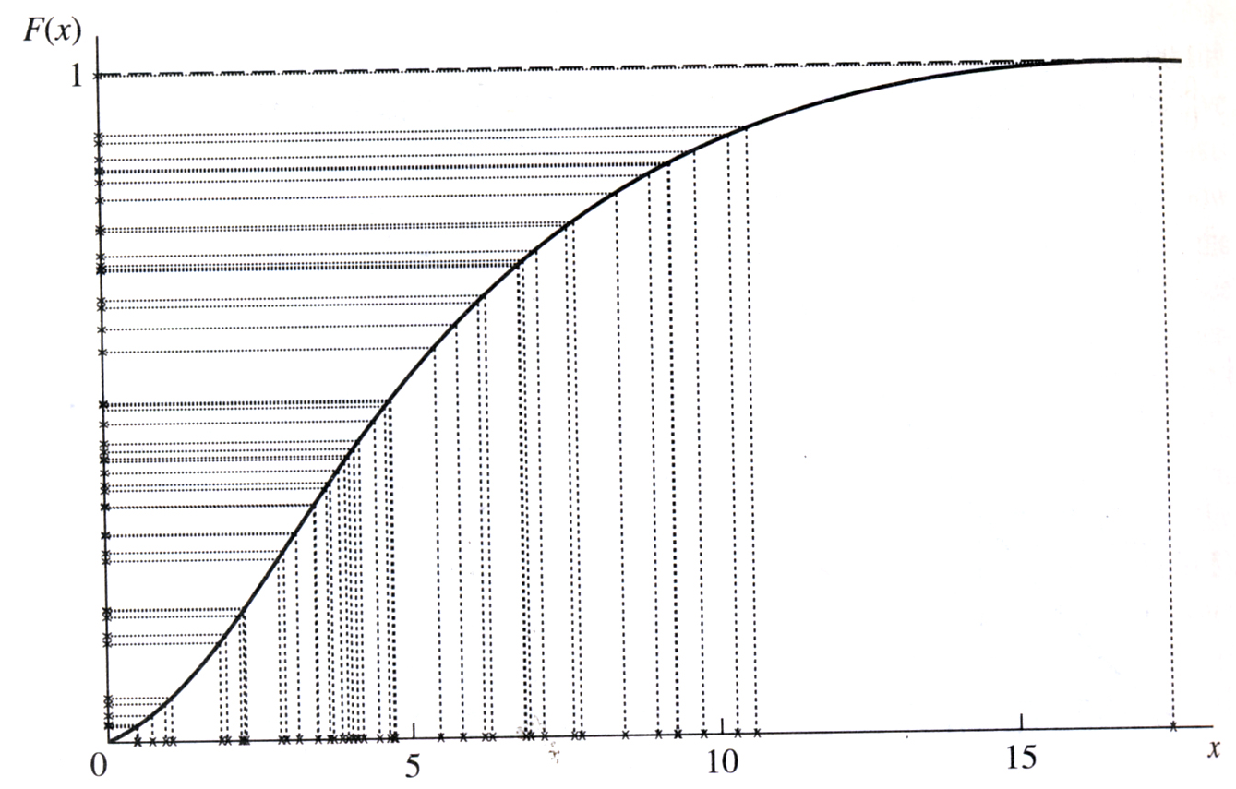

Slide 9
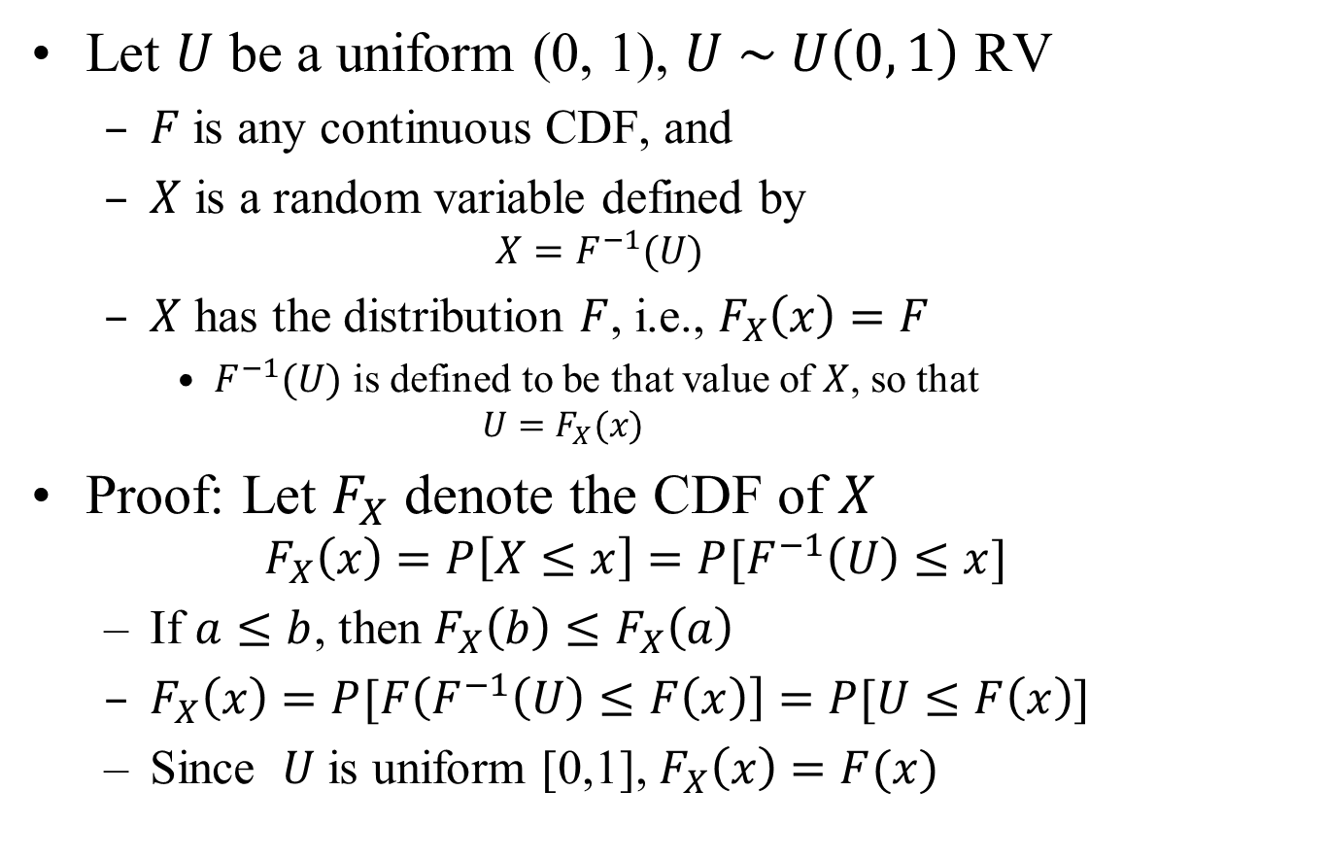
Inverse Transform Method
Let $U$ be a uniform (0, 1), $U \sim U\left(0, 1\right)$ RV
$F$ is any continuous CDF, and
$X$ is a random variable defined by
$$X=F^{−1}(U)$$
$X$ has the distribution $F$, i.e., $F_{X}\left(x\right)=F$
$F^{−1}(U)$ is defined to be that value of $X$, so that
$$U=F_{X}(x)$$
Proof: Let $F_{X}$ denote the CDF of $X$
$$F_{X}\left(x\right)=P\left[X≤x\right]=P[F^{−1}\left(U\right)≤x]$$
If $a≤b$, then $F_{X}\left(b\right)≤F_{X}\left(a\right)$
$F_{X}\left(x\right)=P[F\left(F^{−1}\left(U\right)≤F\left(x\right)\right]=P[U≤F\left(x\right)]$
Since $U$ is uniform [0,1], $F_{X}\left(x\right)=F(x)$

Slide 10
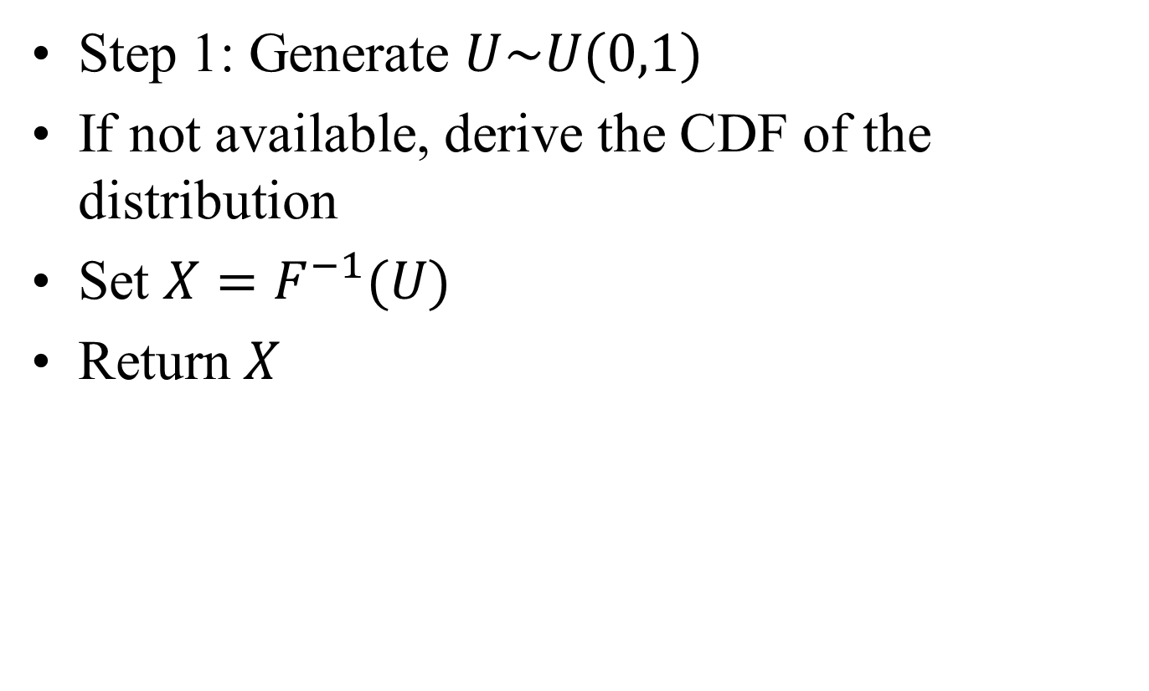
Inverse Transform Method: Algorithm
Step 1: Generate $U\sim U(0,1)$
If not available, derive the CDF of the distribution
Set $X=F^{−1}(U)$
Return $X$

Slide 12
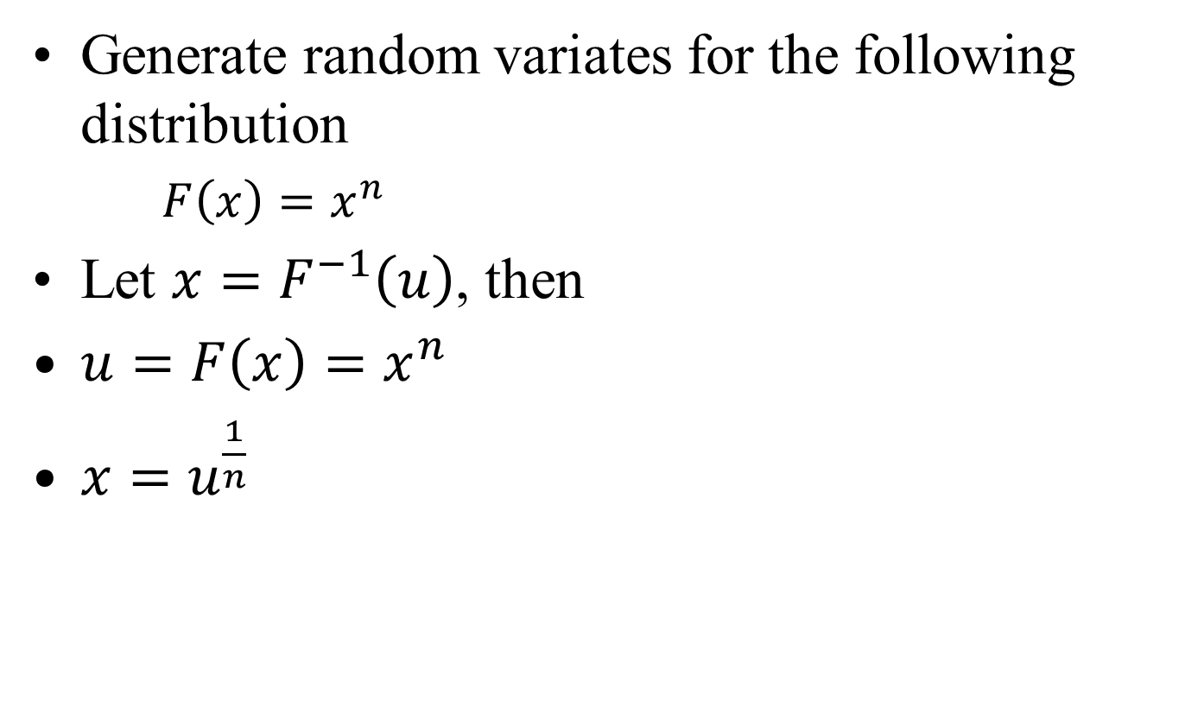
Example 1
Generate random variates for the following distribution
$F\left(x\right)=x^{n}$
Let $x=F^{−1}\left(u\right)$, then
$u=F\left(x\right)=x^{n}$
$x=u^{\frac{1}{n}}$

Slide 13

Example 1: Algorithm
Step 1: Generate $u \sim U(0, 1)$
Step 2: Calculate $x=u^{\frac{1}{n}}$
Step 3: Return $x$

Slide 14
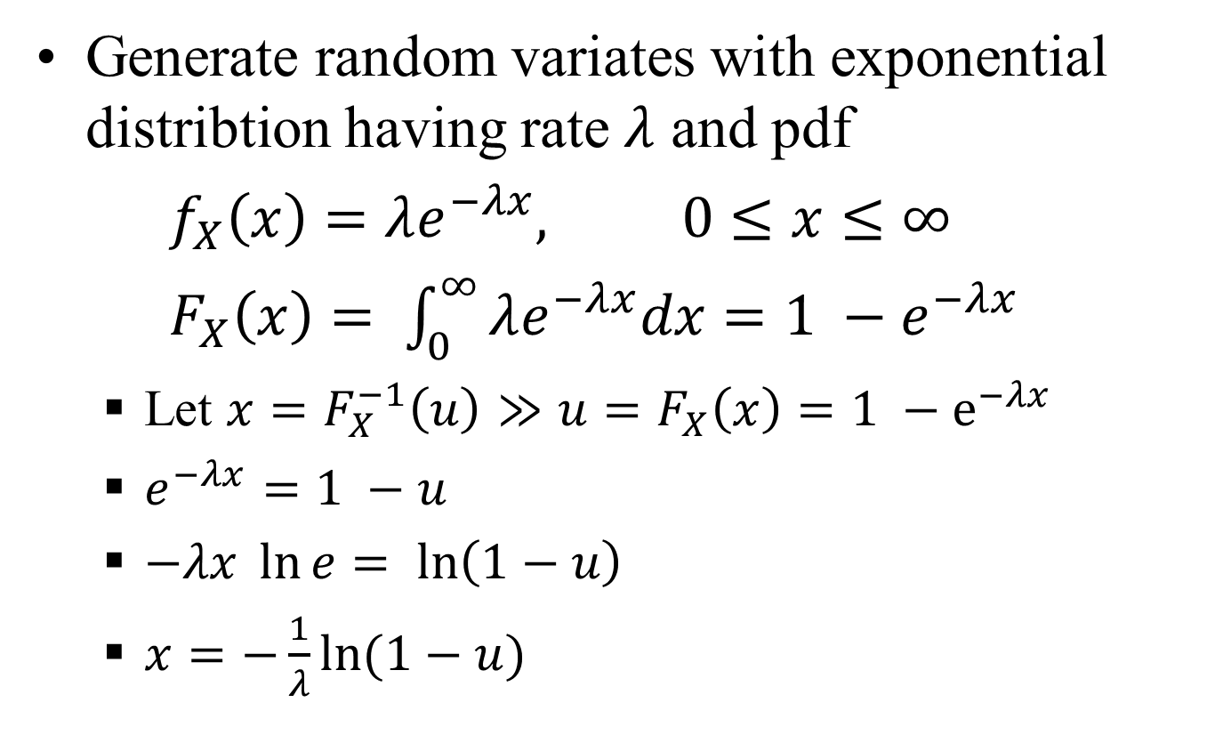
Example 2: Exponential Distribution
Generate random variates with exponential distribtion having rate $λ$ and pdf
$f_{X}\left(x\right)=λe^{−λx}, 0≤x≤∞$
$F_{X}\left(x\right)= \int_{0}^{∞}{λe^{−λx}dx}=1 −e^{−λx}$
Let $x=F_{X}^{−1}\left(u\right)≫u=F_{X}\left(x\right)=1 −e^{−λx}$
$e^{−λx}=1 −u$
$−λx \ln{e}= \ln\left(1−u\right)$
$x=−\frac{1}{λ}\ln{(1−u)}$

Slide 15
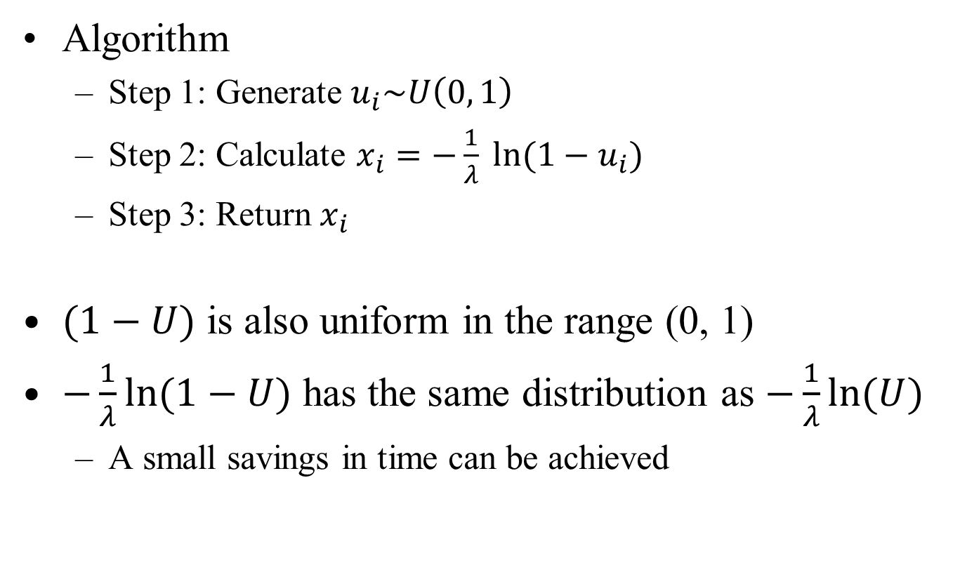
Example 2: Exponential Distribution
Algorithm
Step 1: Generate $u_{i}\sim U\left(0, 1\right)$
Step 2: Calculate $x_{i}=−\frac{1}{λ} \ln{(1−u_{i})}$
Step 3: Return $x_{i}$
$(1−U)$ is also uniform in the range (0, 1)
$−\frac{1}{λ}\ln{(1−U)}$ has the same distribution as $−\frac{1}{λ}\ln{(U)}$
A small savings in time can be achieved

Slide 16
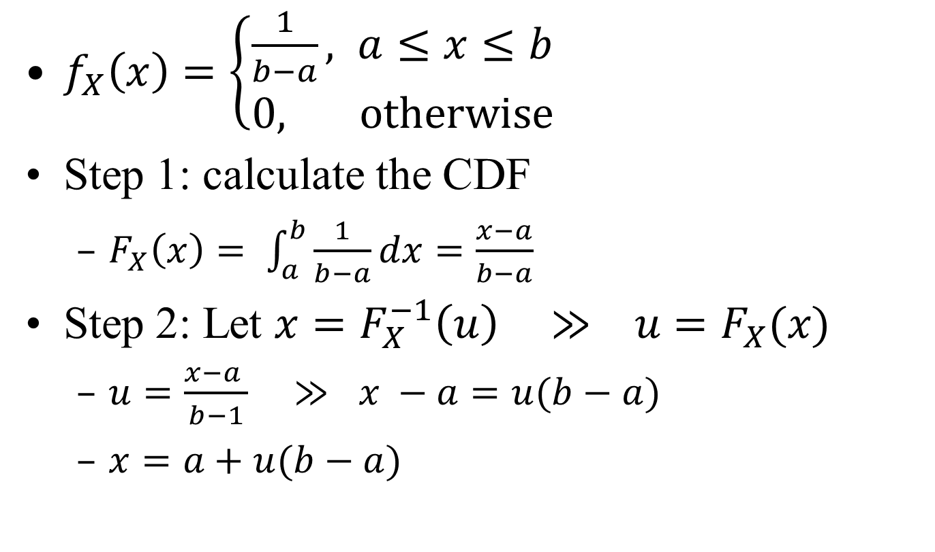
Example 3: Uniform Distribution
$f_{X}\left(x\right)=\left\{\begin{aligned}\frac{1}{b−a}, a≤x≤b \\ 0, otherwise\end{aligned}\right.$
Step 1: calculate the CDF
$F_{X}\left(x\right)= \int_{a}^{b}{\frac{1}{b−a}dx}=\frac{x−a}{b−a}$
Step 2: Let $x=F_{X}^{−1}\left(u\right) ≫ u=F_{X}(x)$
$u=\frac{x−a }{b−1} ≫ x −a=u(b−a)$
$x=a+u(b−a)$

Slide 17

Example 3: Uniform Distribution
Algorithm
Step 1: Generate $u_{i}\sim U(0. 1)$
Step 2: Calculate $x_{i}=a+u_{i}(b−a)$
Step 3: Return $x_{i}$

Slide 18
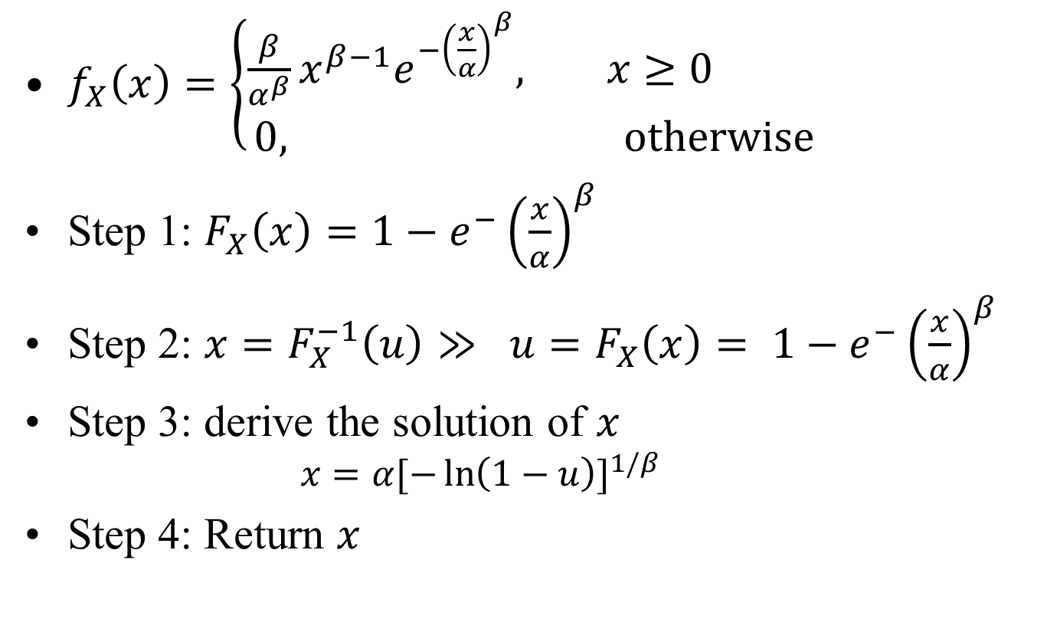
Example 4: Weibull Distribution
$f_{X}\left(x\right)=\left\{\begin{aligned}\frac{β}{α^{β}}x^{β−1}e^{−{\left(\frac{x}{α}\right)}^{β}}, x≥0 \\ 0, otherwise\end{aligned}\right.$
Step 1: $F_{X}\left(x\right)=1−e^{−}{\left(\frac{x}{α}\right)}^{β}$
Step 2: $x=F_{X}^{−1}\left(u\right)≫ u=F_{X}\left(x\right)= 1−e^{−}{\left(\frac{x}{α}\right)}^{β}$
Step 3: derive the solution of $x$
$$x=α[−\ln{{\left(1−u\right)]}^{1/β} }$$
Step 4: Return $x$

Slide 19

Example 4: Weibull Distribution
Algorithm
Step 1: Generate $u_{i}\sim U(0, 1)$
Step 2: Calculate $x_{i}=$ $α[−\ln{{\left(1−u_{i}\right)]}^{\frac{1}{β}}}$
Return $x_{i}$

Slide 20
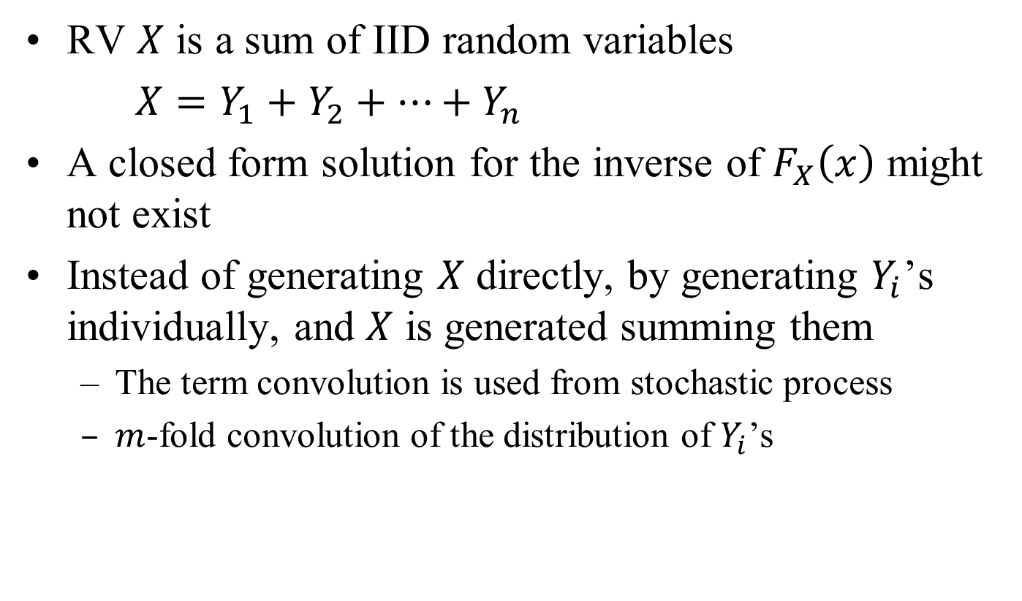
Convolution Method
RV $X$ is a sum of IID random variables
$X=Y_{1}+Y_{2}+…+Y_{n}$
A closed form solution for the inverse of $F_{X}\left(x\right)$ might not exist
Instead of generating $X$ directly, by generating $Y_{i}$’s individually, and $X$ is generated summing them
The term convolution is used from stochastic process
$m$-fold convolution of the distribution of $Y_{i}$’s

Slide 21
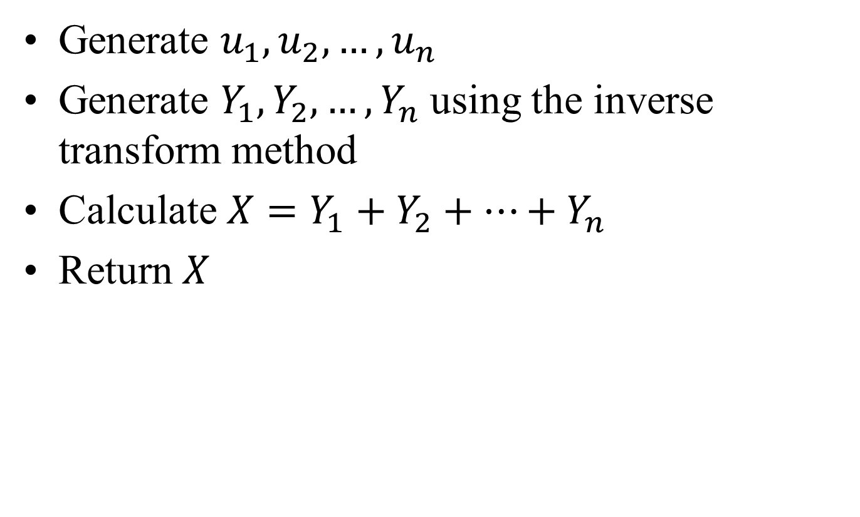
Convolution Method: Algorithm
Generate $u_{1},u_{2}, …, u_{n}$
Generate $Y_{1}, Y_{2}, …, Y_{n}$ using the inverse transform method
Calculate $X=Y_{1}+Y_{2}+…+Y_{n}$
Return $X$

Slide 22
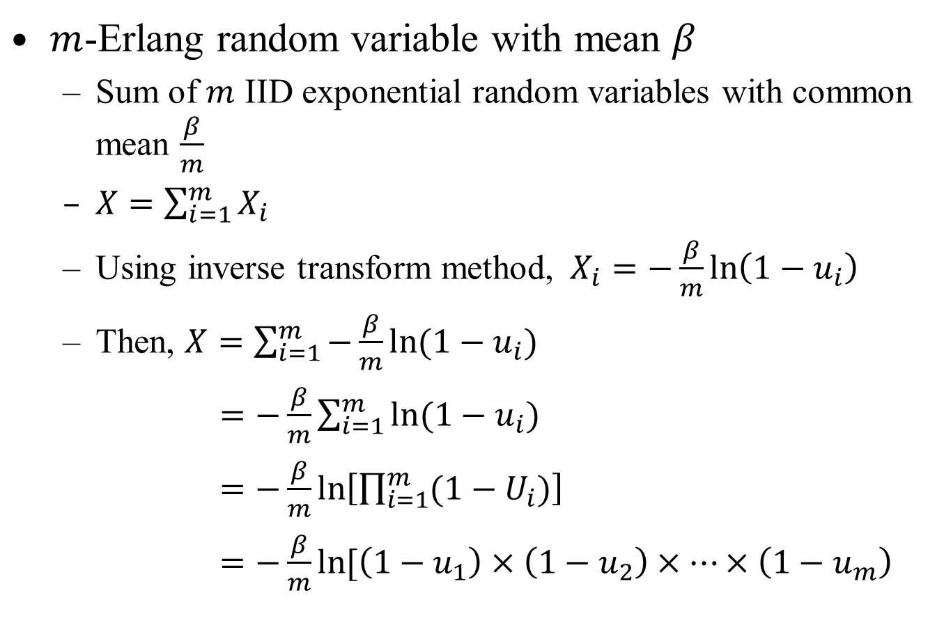

Example: $m$-Erlang Distribution
$m$-Erlang random variable with mean $β$
Sum of $m$ IID exponential random variables with common mean $\frac{β}{m}$
$X=\sum_{i=1}^{m}{X_{i}}$
Using inverse transform method, $X_{i}=−\frac{β}{m}\ln\left(1−u_{i}\right)$
Then, $X=\sum_{i=1}^{m}{−\frac{β}{m}\ln{(1−u_{i})}}$
$=−\frac{β}{m}\sum_{i=1}^{m}{\ln{(1−u_{i})}}$
$=−\frac{β}{m}\ln\left[\prod_{i=1}^{m}{(1−U_{i})}\right]$
$=−\frac{β}{m}\ln{[\left(1−u_{1}\right)×\left(1−u_{2}\right)×…×\left(1−u_{m}\right)}$

Slide 23

Example: $m$-Erlang Distribution
Algorithm
Step 1: Generate $u_{1}, u_{2}, …, u_{n}$
Step 2: Calculate $X=−\frac{β}{m}\ln{[\prod_{i=1}^{m}{(1−u_{i})]}}$
Step 3: Return $X$

Slide 24
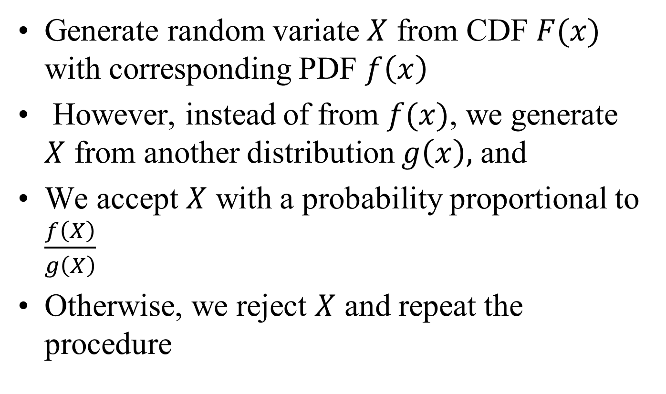
Acceptance-Rejection Method
Generate random variate $X$ from CDF $F(x)$ with corresponding PDF $f\left(x\right)$
However, instead of from $f(x)$, we generate $X$ from another distribution $g\left(x\right),$ and
We accept $X$ with a probability proportional to $\frac{f\left(X\right)}{g\left(X\right)}$
Otherwise, we reject $X$ and repeat the procedure

Slide 25
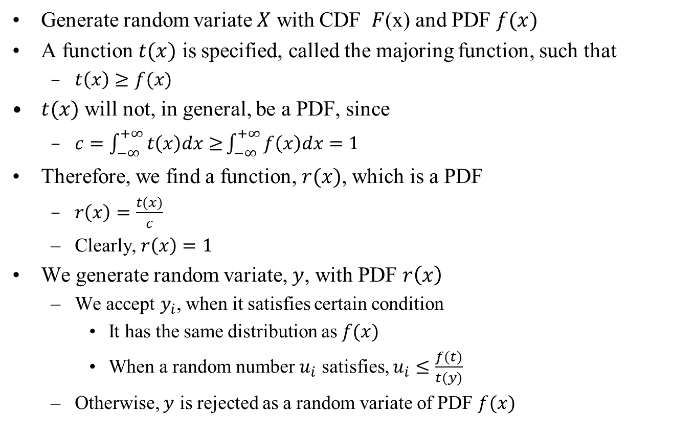
Acceptance-Rejection Method
Generate random variate $X$ with CDF $F$(x) and PDF $f(x)$
A function $t(x)$ is specified, called the majoring function, such that
$t\left(x\right)≥f(x)$
$t(x)$ will not, in general, be a PDF, since
$c=\int_{−∞}^{+∞}{t\left(x\right)dx≥}\int_{−∞}^{+∞}{f\left(x\right)dx=1}$
Therefore, we find a function, $r(x)$, which is a PDF
$r\left(x\right)=\frac{t(x)}{c}$
Clearly, $r\left(x\right)=1$
We generate random variate, $y$, with PDF $r\left(x\right)$
We accept $y_{i}$, when it satisfies certain condition
It has the same distribution as $f(x)$
When a random number $u_{i}$ satisfies, $u_{i}≤\frac{f(t)}{t(y)}$
Otherwise, $y$ is rejected as a random variate of PDF $f(x)$

Slide 26
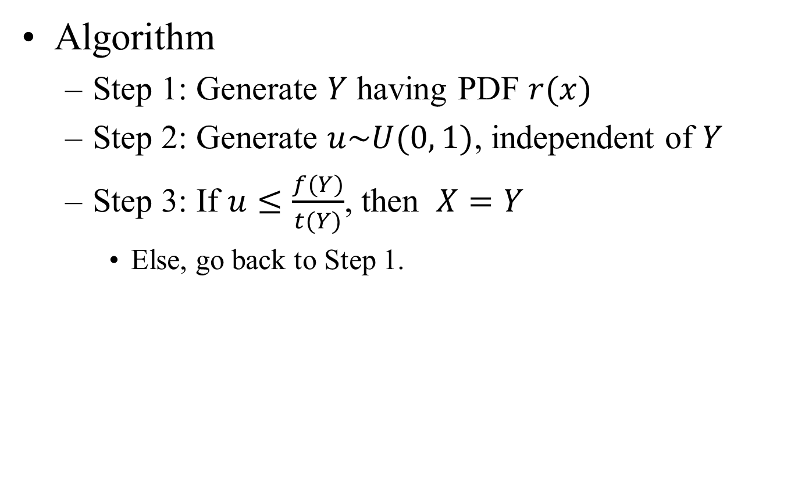
Acceptance-Rejection Method
Algorithm
Step 1: Generate $Y$ having PDF $r(x)$
Step 2: Generate $u\sim U(0, 1)$, independent of $Y$
Step 3: If $u≤\frac{f(Y)}{t(Y)}$, then $X=Y$
Else, go back to Step 1.

Slide 27
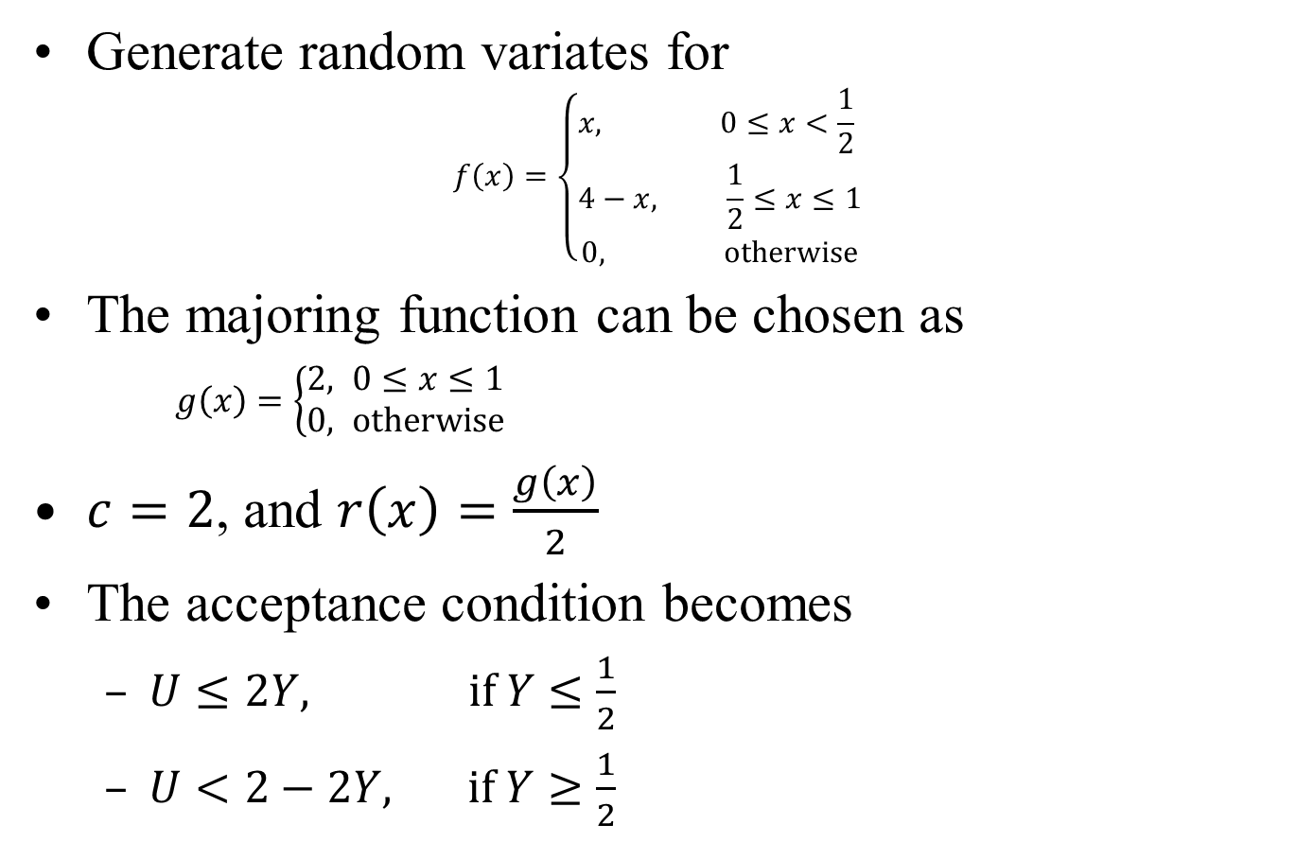
Example 1: Acceptance-Rejection
Generate random variates for
$$f\left(x\right)=\left\{\begin{aligned}&x, 0≤x<\frac{1}{2} \\ &4−x, \frac{1}{2}≤x≤1 \\ 0, otherwise\end{aligned}\right.$$
The majoring function can be chosen as
$g\left(x\right)=\left\{\begin{aligned}2, 0≤x≤1 \\ &0, otherwise\end{aligned}\right.$
$c=2$, and $r\left(x\right)=\frac{g\left(x\right)}{2}$
The acceptance condition becomes
$U≤2Y, if Y≤\frac{1}{2}$
$U<2−2Y, if Y≥\frac{1}{2}$

Slide 28
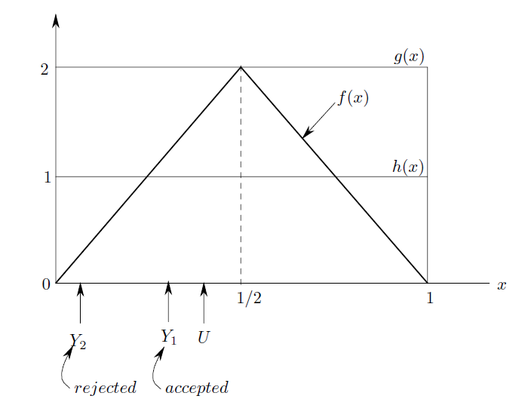
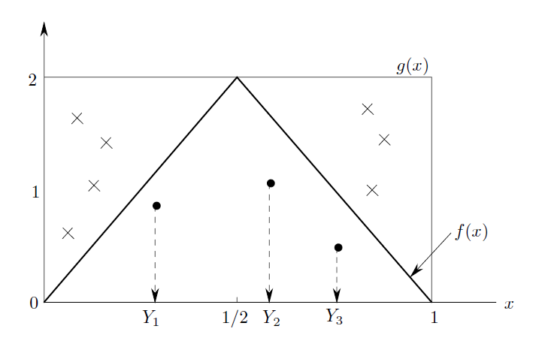
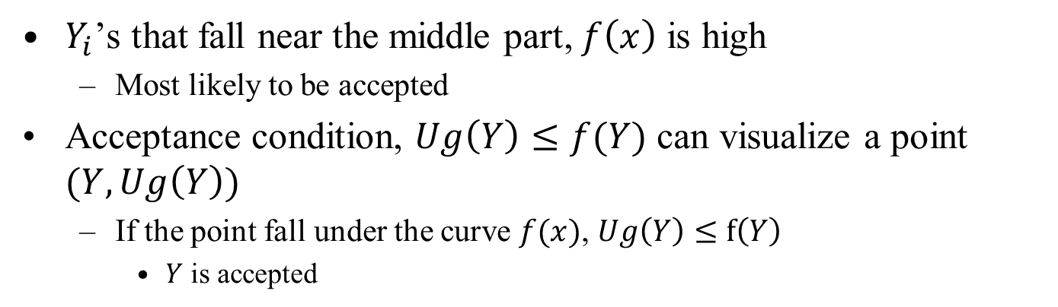
Example 1: Acceptance-Rejection
$Y_{i}$’s that fall near the middle part, $f\left(x\right)$ is high
Most likely to be accepted
Acceptance condition, $Ug\left(Y\right)≤f(Y)$ can visualize a point $(Y, Ug\left(Y\right))$
If the point fall under the curve $f(x)$, $Ug\left(Y\right)≤f\left(Y\right)$
$Y$ is accepted

Slide 29
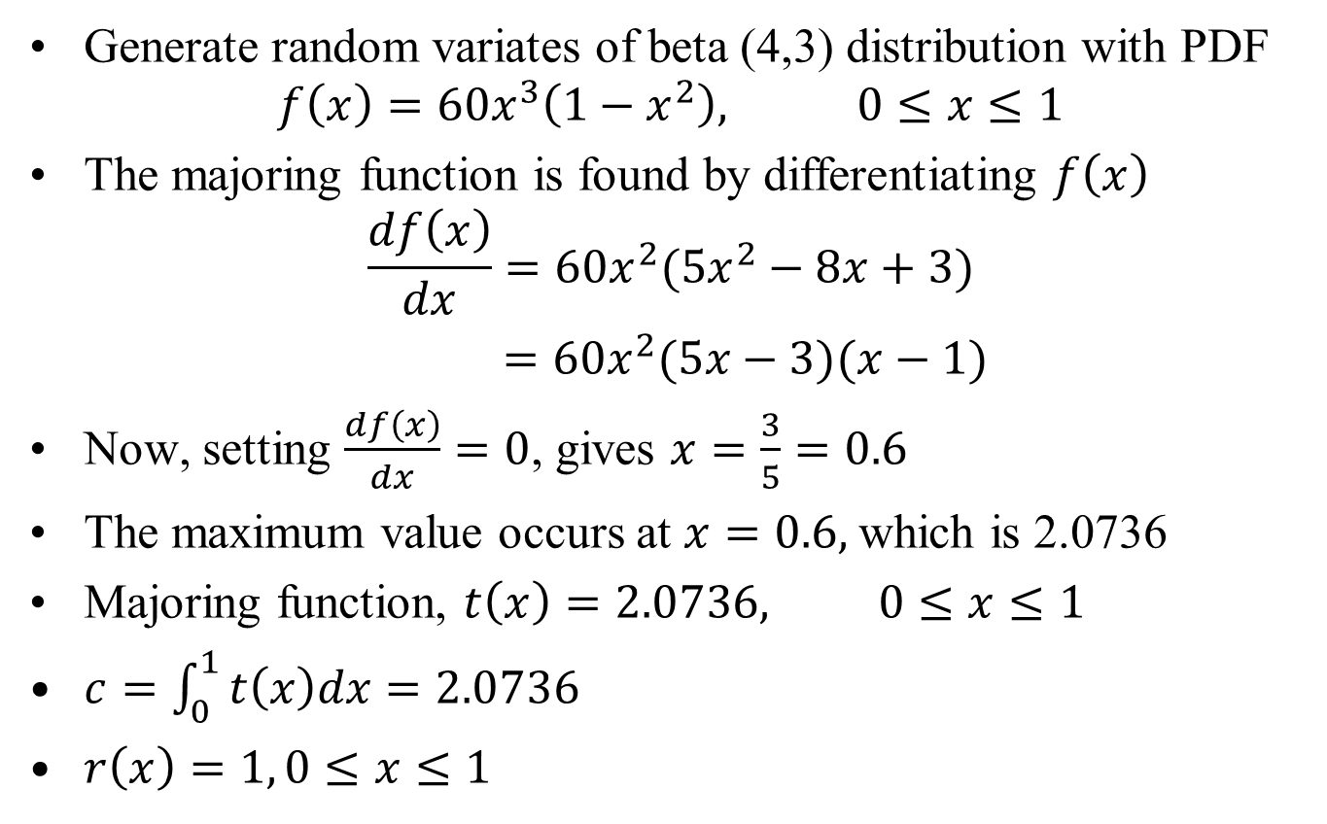
Example 2: Acceptance-Rejection
Generate random variates of beta (4,3) distribution with PDF
$$f\left(x\right)=60x^{3}\left(1−x^{2}\right), 0≤x≤1$$
The majoring function is found by differentiating $f\left(x\right)$
$$\frac{df\left(x\right)}{dx}=60x^{2}(5x^{2}−8x+3)$$
$=60x^{2}(5x−3)(x−1)$
Now, setting $\frac{df\left(x\right)}{dx}=0$, gives $x=\frac{3}{5}=0.6$
The maximum value occurs at $x=0.6,$which is 2.0736
Majoring function, $t\left(x\right)=2.0736, 0≤x≤1$
$c=\int_{0}^{1}{t\left(x\right)dx=2.0736}$
$r\left(x\right)=1, 0≤x≤1$

